Slide 1
Deep Learning

Slide 2

Deep Neural Network
Disclaimer and Acknowledgement
The content for these slides has been obtained from books and various other source on the Internet
I here by acknowledge all the contributors for their material and inputs.
I have provided source information wherever necessary
I have added and modified the content to suit the requirements of the course

Slide 3
Session Agenda
Back Propagation

Slide 4
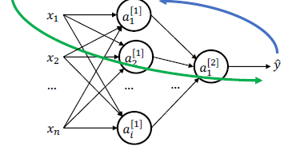
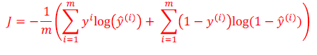
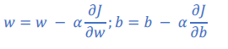
Training: Go Forwards, then Backwards…
Step 3: Calculate partial derivatives (using Backpropagation)
Step 1: Calculate 𝒚 ̂ using
computation graph.
Step 2: Determine the cost.
Step 4: Update each parameter

Slide 5
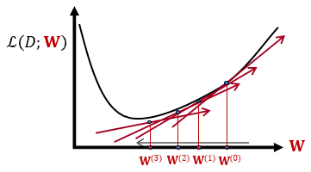
Training Neural Networks: optimizing parameters
We are given an architecture though its weights 𝐖.
Also given a training data 𝐷 = {(𝐱_{𝑖}, 𝑦_{i})}
We are given a loss function ℒ(𝐷; 𝐖)
We can use gradient descent to minimizes the loss.
At each step, the weight vector is modified in the direction that produces the steepest descent along the error surface.

Slide 6
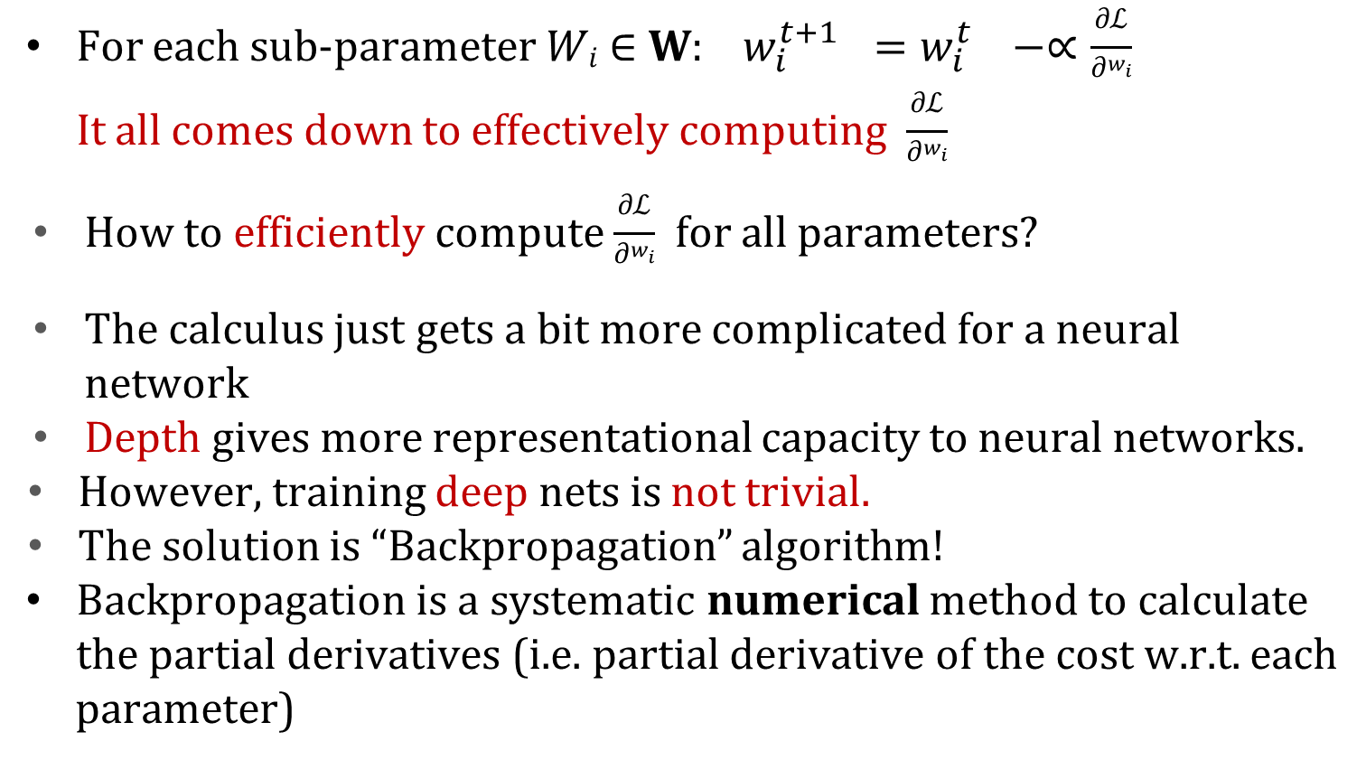
Algorithm for Gradient Computation – Backpropagation
For each sub-parameter 𝑊_{𝑖} ∈ 𝐖: $w_{i}^{t+1 }=w_{i}^{t }−∝\frac{\text{∂}\text{ℒ}}{\text{∂}w_{i}}$ It all comes down to effectively computing $\frac{\text{∂}\text{ℒ}}{\text{∂}w_{i}}$
How to efficiently compute $\frac{\text{∂}\text{ℒ}}{\text{∂}w_{i}}$ for all parameters?
The calculus just gets a bit more complicated for a neural network
Depth gives more representational capacity to neural networks.
However, training deep nets is not trivial.
The solution is “Backpropagation” algorithm!
Backpropagation is a systematic numerical method to calculate the partial derivatives (i.e. partial derivative of the cost w.r.t. each
parameter)
Rumelhart, Hinton, Williams, “Learning Representations by Back-Propagating Errors”, 1986

Slide 7
Key Intuitions Required for Backpropagation
Gradient Descent
Change the weights 𝐖 in the direction of gradient to minimize the error function.
Chain Rule
Use the chain rule to calculate the weights of the intermediate weights
Dynamic Programming (Memorization)
Parameter gradients depend on the gradients of the earlier layers!
So, when computing gradients at each layer, we can reuse gradients computed for higher layers for lower layers (i.e., memorization).

Slide 8
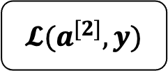
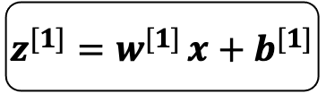
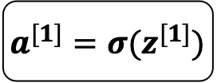
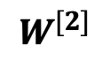
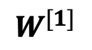
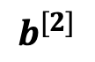
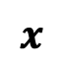
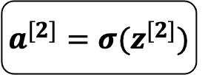
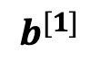
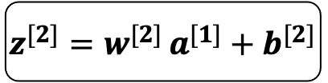
The Computation Graph of A Neural Network
we can represent any neural network in terms of a computation graph
The loss function can be computed by moving from left to right
$$b^{[2]}$$
$$b^{[1]}$$
$$W^{[2]}$$
$$x$$
$$z^{[1]}=w^{[1] }x+b^{[1]}$$
$$a^{[1]}=σ(z^{[1]})$$
$$z^{[2]}=w^{[2] }a^{[1]}+b^{[2]}$$
$$a^{[2]}=σ(z^{[2]})$$
$$𝓛(a^{[2]},y)$$
$$W^{[1]}$$
The corresponding computation graph
Cross entropy cost function:
$$Cost\left(ŷ,y\right)=−y∗logŷ−\left(1−y\right)log\left(1−ŷ\right)$$

Slide 9
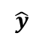
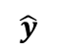
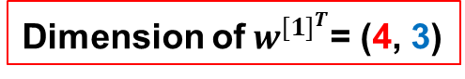
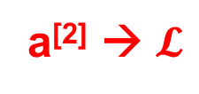
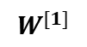
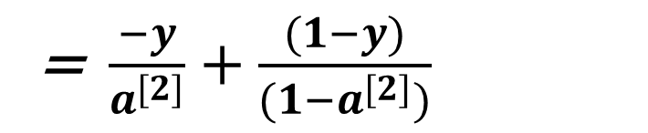
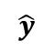
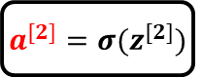
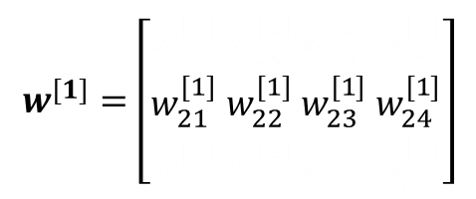

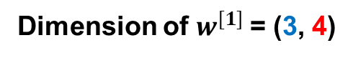
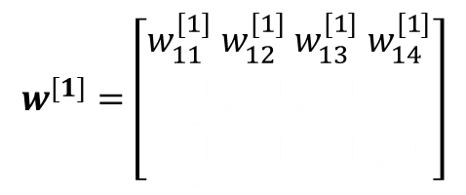
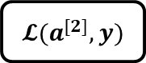
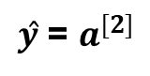
Backward Propagation
$$b^{[2]}$$
$ŷ$ = $a^{[2]}$
$$b^{[1]}$$
$$W^{[2]}$$
$$x$$
$$z^{[1]}=w^{[1] }x+b^{[1]}$$
$$a^{[1]}=σ(z^{[1]})$$
$$z^{[2]}=w^{[2] }a^{[1]}+b^{[2]}$$
$$a^{[2]}=σ(z^{[2]})$$
$$𝓛(a^{[2]},y)$$
$$W^{[1]}$$
a^{[2]} → $𝓛$
$$\frac{∂𝓛}{∂a^{[2]}}= \frac{∂}{∂a[2]}\left(−ylog\left(a[2]\right)−\left(1−y\right)log\left(1−a[2]\right)\right)$$
= $\frac{−y}{a^{[2]}}+\frac{(1−y)}{(1−a^{[2]})}$

Slide 10
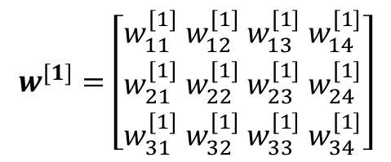
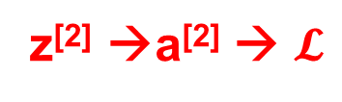
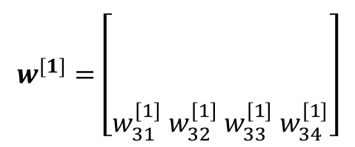
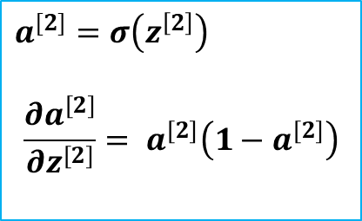
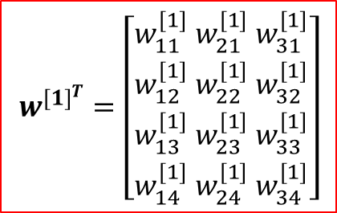
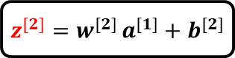
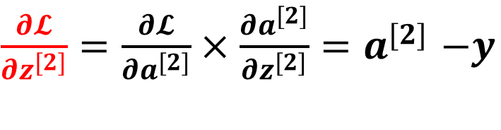
Backward Propagation
$$b^{[2]}$$
$$b^{[1]}$$
$$W^{[2]}$$
$$x$$
$$z^{[1]}=w^{[1] }x+b^{[1]}$$
$$a^{[1]}=σ(z^{[1]})$$
$$z^{[2]}=w^{[2] }a^{[1]}+b^{[2]}$$
$$a^{[2]}=σ(z^{[2]})$$
$$𝓛(a^{[2]},y)$$
$$W^{[1]}$$
z^{[2]} →a^{[2]} → $𝓛$
$$a^{[2]}=σ\left(z^{\left[2\right]}\right)$$
$$\frac{∂a^{[2]}}{∂z^{[2]}}= a^{[2]}\left(1−a^{[2]}\right)$$
$\frac{∂𝓛}{∂z^{[2]}}=\frac{∂𝓛}{∂a^{[2]}}×\frac{∂a^{[2]}}{∂z^{[2]}}$ ${=a}^{[2]}−y$

Slide 11
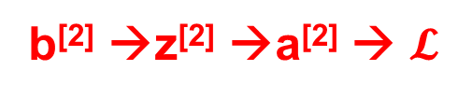
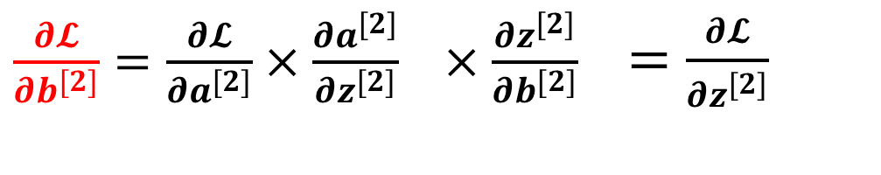
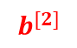
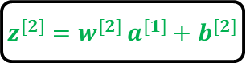
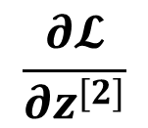
Backward Propagation
$$b^{[2]}$$
$$b^{[1]}$$
$$W^{[2]}$$
$$x$$
$$z^{[1]}=w^{[1] }x+b^{[1]}$$
$$a^{[1]}=σ(z^{[1]})$$
$$z^{[2]}=w^{[2] }a^{[1]}+b^{[2]}$$
$$a^{[2]}=σ(z^{[2]})$$
$$𝓛(a^{[2]},y)$$
$$W^{[1]}$$
b^{[2]} →z^{[2]} →a^{[2]} → $𝓛$
$\frac{∂𝓛}{∂b^{[2]}}=\frac{∂𝓛}{∂a^{[2]}}×\frac{∂a^{[2]}}{∂z^{[2]}} ×\frac{∂z^{[2]}}{∂b^{[2]}}$ $=\frac{∂𝓛}{∂z^{[2]}}$
$$\frac{∂𝓛}{∂z^{[2]}}$$
1

Slide 12
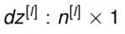
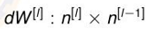
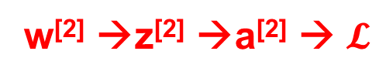
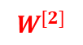
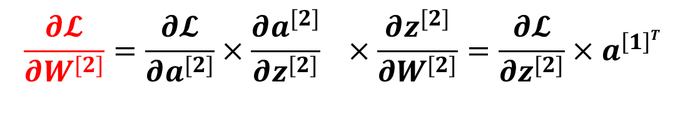
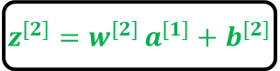
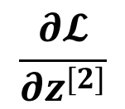
Backward Propagation
$$b^{[2]}$$
$$b^{[1]}$$
$$W^{[2]}$$
$$x$$
$$z^{[1]}=w^{[1] }x+b^{[1]}$$
$$a^{[1]}=σ(z^{[1]})$$
$$z^{[2]}=w^{[2] }a^{[1]}+b^{[2]}$$
$$a^{[2]}=σ(z^{[2]})$$
$$𝓛(a^{[2]},y)$$
$$W^{[1]}$$
w^{[2]} →z^{[2]} →a^{[2]} → $𝓛$
$$\frac{∂𝓛}{∂W^{[2]}}=\frac{∂𝓛}{∂a^{[2]}}×\frac{∂a^{[2]}}{∂z^{[2]}} ×\frac{∂z^{[2]}}{∂W^{[2]}}=\frac{∂𝓛}{∂z^{[2]}}{×a}^{\left[1\right]T}$$
Dimension of dz^{[2]} is (n^{[2]},1)
Dimension of a^{[1]} is (n^{[1]},1)
Hence transpose of a^{[1]}
Dimension of dW^{[2]} is (n^{[2]}, n^{[1]})
$$\frac{∂𝓛}{∂z^{[2]}}$$

Slide 13
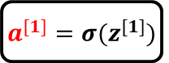
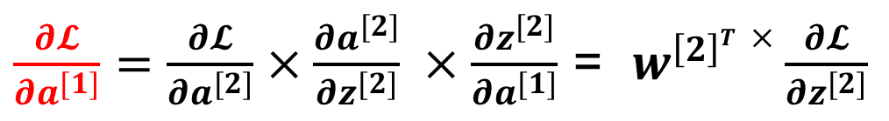
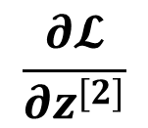


Backward Propagation
$$b^{[1]}$$
$$W^{[2]}$$
$$x$$
$$z^{[1]}=w^{[1] }x+b^{[1]}$$
$$a^{[1]}=σ(z^{[1]})$$
$$z^{[2]}=w^{[2] }a^{[1]}+b^{[2]}$$
$$a^{[2]}=σ(z^{[2]})$$
$$𝓛(a^{[2]},y)$$
$$W^{[1]}$$
$$b^{[2]}$$
a^{[1]} →z^{[2]} →a^{[2]} → $𝓛$
$\frac{∂𝓛}{∂a^{[1]}}=\frac{∂𝓛}{∂a^{[2]}}×\frac{∂a^{[2]}}{∂z^{[2]}} ×\frac{∂z^{[2]}}{∂a^{[1]}}$ = $w^{\left[2\right]T}×\frac{∂𝓛}{∂z^{[2]}}$
$$\frac{∂𝓛}{∂z^{[2]}}$$
Dimension of dz^{[2]} is (n^{[2]},1)
Dimension of W^{[2]} is (n^{[2]}, n^{[1]})
Dimension of da^{[1]} is (n^{[1]},1)
But, the calculation of da^{[1]} is not required.

Slide 14







Backward Propagation
Dimension of dz^{[2]} is (n^{[2]},1)
Dimension of W^{[2]} is (n^{[2]}, n^{[1]})
Dimension of da^{[1]} is (n^{[1]},1)
Dimension of dz^{[1]} is (n^{[1]},1)
$$b^{[2]}$$
$$b^{[1]}$$
$$W^{[2]}$$
$$x$$
$$z^{[1]}=w^{[1] }x+b^{[1]}$$
$$a^{[1]}=σ(z^{[1]})$$
$$z^{[2]}=w^{[2] }a^{[1]}+b^{[2]}$$
$$a^{[2]}=σ(z^{[2]})$$
$$𝓛(a^{[2]},y)$$
$$W^{[1]}$$
z^{[1]} →a^{[1]} →z^{[2]} →a^{[2]} → $𝓛$
Element-wise product
$$\frac{∂𝓛}{∂z^{[1]}}=\frac{∂𝓛}{∂a^{[2]}}×\frac{∂a^{[2]}}{∂z^{[2]}}×\frac{∂z^{[2]}}{∂a^{[1]}}×\frac{∂a^{[1]}}{∂z^{[1]}}=\left(w^{\left[2\right]T}×\frac{∂𝓛}{∂z^{[2]}}\right)∗a^{[1]}(1−a^{[1]})$$
$$a^{[1]}=σ\left(z^{\left[1\right]}\right)$$
$$\frac{∂a^{[1]}}{∂z^{[1]}}= a^{[1]}\left(1−a^{[1]}\right)$$
$$\frac{∂𝓛}{∂a^{[1]}}$$

Slide 15





Backward Propagation
$$b^{[2]}$$
$$b^{[1]}$$
$$W^{[2]}$$
$$x$$
$$z^{[1]}=w^{[1] }x+b^{[1]}$$
$$a^{[1]}=σ(z^{[1]})$$
$$z^{[2]}=w^{[2] }a^{[1]}+b^{[2]}$$
$$a^{[2]}=σ(z^{[2]})$$
$$𝓛(a^{[2]},y)$$
$$W^{[1]}$$
b^{[1]} → z^{[1]} →a^{[1]} →z^{[2]} →a^{[2]} → $𝓛$
$$\frac{∂𝓛}{∂b^{[1]}}=\frac{∂𝓛}{∂a^{[2]}}×\frac{∂a^{[2]}}{∂z^{[2]}}×\frac{∂z^{[2]}}{∂a^{[1]}}×\frac{∂a^{[1]}}{∂z^{[1]}}×\frac{∂z^{[1]}}{∂b^{[1]}} =\frac{∂𝓛}{∂z^{[1]}}$$
$$1$$

Slide 16




Backward Propagation
$$b^{[2]}$$
$$b^{[1]}$$
$$W^{[2]}$$
$$x$$
$$z^{[1]}=w^{[1] }x+b^{[1]}$$
$$a^{[1]}=σ(z^{[1]})$$
$$z^{[2]}=w^{[2] }a^{[1]}+b^{[2]}$$
$$a^{[2]}=σ(z^{[2]})$$
$$𝓛(a^{[2]},y)$$
$$W^{[1]}$$
W^{[1]}→ z^{[1]} →a^{[1]} →z^{[2]} →a^{[2]} → $𝓛$
$$\frac{∂𝓛}{∂w^{[1]}}=\frac{∂𝓛}{∂a^{[2]}}×\frac{∂a^{[2]}}{∂z^{[2]}}×\frac{∂z^{[2]}}{∂a^{[1]}}×\frac{∂a^{[1]}}{∂z^{[1]}}×\frac{∂z^{[1]}}{∂w^{[1]}} =\frac{∂𝓛}{∂z^{[1]}}{ x}^{T}$$
x

Slide 17










Backward Propagation: Summary
One training example
For all training example
For cross entropy loss and sigmoid activation in the last layer
$$dZ^{[2]}=\frac{∂𝓛}{∂Z^{[2]}}{=A}^{[2]}−Y$$
$$dz^{[2]}=\frac{∂𝓛}{∂z^{[2]}}{=a}^{[2]}−y$$
$$db^{[2]}=\frac{∂𝓛}{∂b^{[2]}}=\frac{1}{m}\sum{dZ^{[2]}}$$
$$db^{[2]}=\frac{∂𝓛}{∂b^{[2]}}=dz^{[2]}$$
$$dW^{[2]}=\frac{∂𝓛}{∂W^{[2]}}=\frac{1}{m}\left(dZ^{[2]}{ . A}^{\left[1\right]T}\right)$$
$$dw^{[2]}=\frac{∂𝓛}{∂W^{[2]}}=dz^{[2]}{ . a}^{\left[1\right]T}$$
$dZ^{[1]}=$ $\frac{∂𝓛}{∂Z^{[1]}}=\left({ W}^{\left[2\right]T}dZ^{[2]}\right)∗g^{[1]`}\left(Z^{[1]}\right)$
$dz^{[1]}=$ $\frac{∂𝓛}{∂z^{[1]}}=\left(w^{\left[2\right]T}dz^{[2]}\right)∗g^{`}\left(z^{[1]}\right)$
$$db^{[1]}=\frac{∂𝓛}{∂b^{[1]}}=\frac{1}{m}\sum{dZ^{[1]}}$$
$$db^{[1]}=\frac{∂𝓛}{∂b^{[1]}}=dz^{[1]}$$
$$dW^{[1]}=\frac{∂𝓛}{∂W^{[1]}}=\frac{1}{m}\left(dZ^{[1]} . X^{T}\right)$$
$dw^{[1]}=\frac{∂𝓛}{∂w^{[1]}}=dz^{[1]}$ $. x^{T}$

Slide 18








Equations for layer l
One training example
For all training example
Input da^{[l]}
Output da^{[l-1],} dw^{[l]} , db^{[l]}
$$dZ^{[l]}=dA^{[l]}∗g^{[l]`}\left(Z^{[l]}\right)$$
$$dz^{[l]}=da^{[l]}∗g^{[l]`}\left(z^{[l]}\right)$$
$$db^{[l]}=\frac{1}{m}\sum{dZ^{[l]}}$$
$$db^{[l]}=dz^{[l]}$$
$$dW^{[l]}=\frac{1}{m}\left(dZ^{[l]}{ . A}^{\left[l−1\right]T}\right)$$
$$dW^{[l]}=dz\left[l\right]{ . a}^{\left[l−1\right]}$$
$$da^{[l−1]}=W^{\left[l\right]T }dz^{[l]}$$
$$dA^{[l−1]}={ W}^{\left[l\right]T }dZ^{[l]}$$

Slide 19




Forward Propagation Algorithm
Scaling up for L layers and all training examples in NN
Forward propagation:
Output
Input
Cache output
Backward propagation:
Cache input
Output
Input

Slide 20

Update the Parameters
Scaling up for L layers and all training examples in NN

Slide 21

Scaling up for L layers and all training examples in NN

Slide 22


Example
Calculate all matrix dimensions and total number of parameters

Slide 23




Array broadcasting
Source:numpy.org

Slide 24


Array broadcasting
Source:numpy.org

Slide 25

Array broadcasting
Source:numpy.org

Slide 26
Exercise - MSE Loss
Consider the neural network with two inputs x₁ and x₂ and the initial weights are w₀ = 0.5, w₁ = 0.8, w₂ = 0.3. Draw the network, compute the output, mean squared loss function and weight updation when the input is (1, 0), the learning rate is 0.01 and target output is 1. Assume any other relevant information.
1
w₀
w₁
Σ
x₁
σ
yˆ
w₂ x₂

Slide 27

Solution

Slide 28
Exercise - BCE
Consider the neural network with two inputs x₁ and x₂ and the initial weights are w₀ = 0.5, w₁ = 0.8, w₂ = 0.3. Draw the network, compute the output, binary cross entropy loss function and weight updation when the input is (1, 0), the learning rate is 0.01 and target output is 1. Assume any other relevant information.
1
w₀
w₁
Σ
x₁
σ
yˆ
w₂ x₂

Slide 29

Solution

Slide 30





















Exercise (without vectorization)
W₁₁^{[1]} =0.2
W₁₂^{[1]} =0.4
W₁₃^{[1]} = -0.5
W₂₁^{[1]} = -0.3
W₂₂^{[1]} =0.1
W₂₃^{[1]} =0.2
W₁₁^{[2]} =-0.3
W₁₂^{[2]} = -0.2
b₁^{[1]} = -0.4
b₂^{[1]} = -0.2
b₁^{[2]} = 0.1
$$w_{11}^{[1]}$$
$$z_{1}^{[1]}$$
$$a_{1}^{[1]}$$
$$w_{11}^{[2]}$$
$$x_{1}$$
$$w_{12}^{[1]}$$
$$w_{13}^{[1]}$$
$$b_{1}^{[1]}$$
$$z_{1}^{[2]}$$
$$a_{1}^{[2]}$$
$$\hat{y}$$
$$x_{2}$$
$$w_{21}^{[1]}$$
$$w_{12}^{[2]}$$
$$b_{1}^{[2]}$$
$$w_{22}^{[1]}$$
$$z_{2}^{[1]}$$
$$a_{2}^{[1]}$$
$$x_{3}$$
$$w_{23}^{[1]}$$
$$b_{2}^{[1]}$$
α=0.9
For X= { 1, 0, 1} and y=1
Find the cross entropy loss and weight updates after 1st iteration

Slide 31


Slide 32



Continued……
For the layer 2
$$d{z1}^{[2]}=\frac{∂𝓛}{∂{z1}^{[2]}}{=a1}^{[2]}−y$$
← For Cross entropy cost function
$$d{z1}^{[2]}=\frac{∂𝓛}{∂{z1}^{\left[2\right]}}{=a1}^{\left[2\right]}\left(1−{a1}^{\left[2\right]}\right)(y −{a1}^{\left[2\right]})$$
← For MSE cost function

Slide 33


Slide 34


Slide 35


Slide 36










Exercise – With vectorization
1
x
_{W} [1]
4 5
0
3 6
prod = W ^{[1]T}x
_{b}[1]
−1
1
-1
-2
1
−2
7
y = 1
z^{[1]} = prod + b^{[1]}
x₁
_{a}[0]
4
_{a}[1]
-3
_{a}[2]
yˆ
_{W} [2]
1
5
1
1
_{a}[1] _{= σ(z}[1]₎
−3 −2
3
-2
₇
yˆ
_{a}[0]
6
_{a}[1]
_{prod = W} [2]T_{a}[1]
_{b}[2]
x₂
2
2
z^{[2]} = prod + b^{[2]}
_{a}[2] _{= σ(z}[2]₎

Slide 37





Computation Graph for Forward Pass
1 4 5
x
_{W} [1]
0 3 6
4
prod = W ^{[1]T}x
_{b}[1]
−1
3
−2
3
z^{[1]} = prod + b^{[1]}
1
0.95
_{a}[1] _{= σ(z}[1]₎
_{W} [2]
−3 −2
0.73
−4.31
_{b}[2]
₇
yˆ
_{prod = W} [2]T_{a}[1]
2.69
z^{[2]} = prod + b^{[2]}
0.94
₁
_{a}[2] _{= σ(z}[2]₎

Slide 38

Computation Graph for Cost Function

Slide 39

Computation Graph for Backward Pass

Slide 40
Demo
https://playground.tensorflow.org/

Slide 41
Practice problems

Slide 42

Example 1 Computational Graph for Back Propagation

Slide 43

Computational Graph for Back Propagation

Slide 44

Computational Graph for Back Propagation

Slide 45

Computational Graph for Back Propagation

Slide 46

Computational Graph for Back Propagation

Slide 47

Computational Graph for Back Propagation

Slide 48

Computational Graph for Back Propagation

Slide 49

Computational Graph for Back Propagation

Slide 50

Computational Graph for Back Propagation

Slide 51

Computational Graph for Back Propagation

Slide 52

Computational Graph for Back Propagation

Slide 53

Computational Graph for Back Propagation

Slide 54

Computational Graph for Back Propagation

Slide 55

Computational Graph for Back Propagation

Slide 56

Computational Graph for Back Propagation

Slide 57

Computational Graph for Back Propagation

Slide 58

Computational Graph for Back Propagation

Slide 59

Example 2
59

Slide 60

60

Slide 61


61

Slide 62
Optional

Slide 63

Derivative of cost function w.r.t final layer linear function

Slide 64

Derivative of cost function w.r.t final layer linear function (Derivative of sigmoid activation function)

Slide 65

Derivative of cost function w.r.t final layer linear function

Slide 66
Thank You All !

